Slide 1


Partnering to accelerate
Social Progress – examples of frameworks

Slide 2
The process
Understand and analyze the work that you have done in the last weeks/months.
To help identify candidate indicators based on the work we have done already with other councils.
To review the relevance and quality of the proposed indicators to fit with the model.

Slide 3
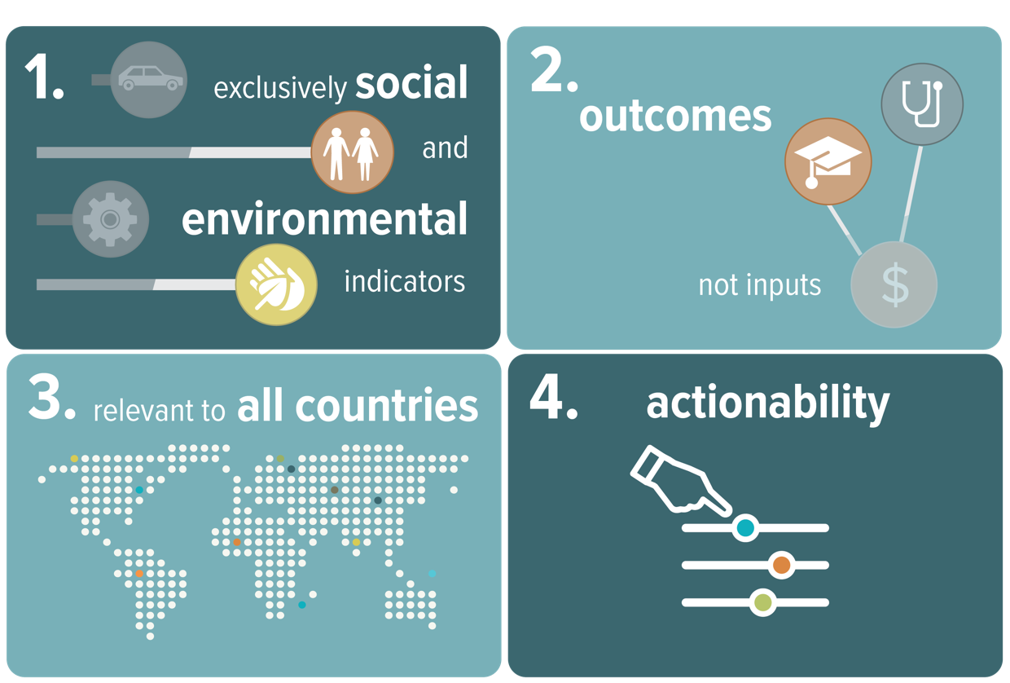

Unique design principles
Social and environmental indicators only Measures social progress exclusively and directly, independent of economic indicators.
Outcomes, not inputs Measures outcomes or lived experience, regardless of effort spent.
Holistic and relevant to all communities Multidimensional measure that encompasses the many inter-related aspects of thriving societies everywhere.
Actionability Practical tool that helps leaders and decision-makers implement policies and programs to drive faster social progress.
The Social Progress Index (SPI) design principles allows an exclusive analysis of social progress

Slide 4
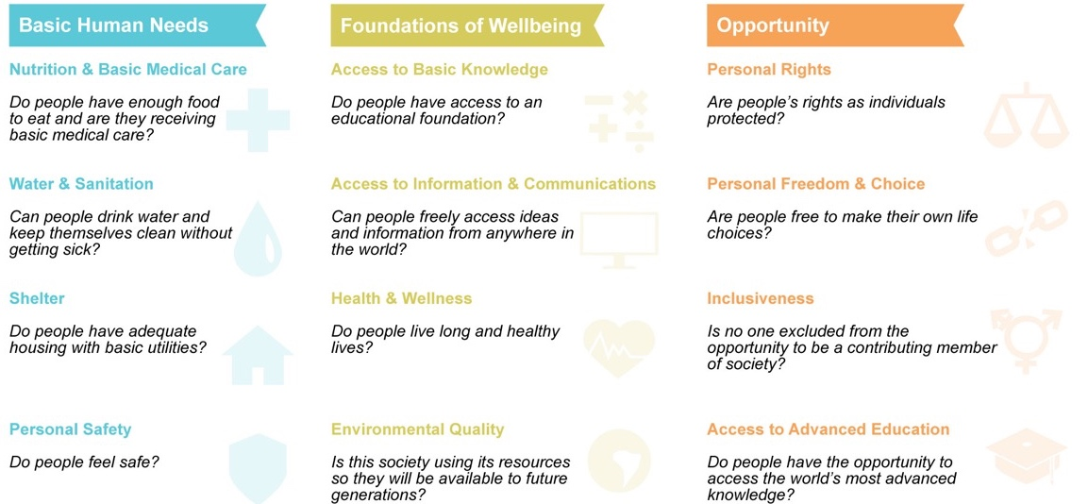

As a complement to GDP, SPI answers universally important questions about the success of society that measures of economic progress cannot alone address.
4

Slide 5
European Regional Social Progress Index Framework
Basic Human Needs
Foundations of Wellbeing
Opportunity
Nutrition and Basic Medical Care
1. Premature mortality (<65)
2. Infant mortality
3. Unmet medical needs
4. Insufficient food
Water and Sanitation
5. Satisfaction with water quality
6. Lack of toilet in dwelling
7. Uncollected sewage
8. Sewage treatment
Shelter
9. Burdensome cost of housing
10. Satisfaction with housing
11. Overcrowding
12. Lack of adequate heating
Personal Safety
13. Homicide rate
14. Safety at night
15. Traffic deaths
Access to Basic Knowledge
16. Upper-secondary enrolment rate
17. Lower secondary completion only
18. Early school leavers
Access to Information and
Communications
19. Internet at home
20. Broadband at home
21. Online interaction
with public authorities
Health and Wellness
22. Life expectancy
23. General health status
24. Standardized cancer death rate
25. Standardized heart disease death rate
26. Unmet dental needs
27. Satisfaction with air quality
Environmental Quality
28. Air pollution-pm10
29. Air pollution-pm2.5
30. Air pollution-ozone
31. Pollution or grime
32. Protected land (Natura 2000)
Personal Rights
33. Trust in the political system
34. Trust in the legal system
35. Trust in the police
36. Quality of public services
Personal Freedom and Choice
37. Freedom over life choices
38. Teenage pregnancy
39. Young people not in education,
employment or training
40. Corruption index
Inclusiveness
41. Impartiality of government services
42. Tolerance for immigrants
43. Tolerance for minorities
44. Attitudes toward people with disabilities
45. Tolerance for homosexuals
46. Gender employment gap
47. Community safety net
Access to Advanced Education
48. Tertiary education attainment
49. Tertiary enrolment
50. Lifelong learning

Slide 6
US States Progress Index Framework
Basic Human Needs
Foundations of Wellbeing
Opportunity
Nutrition and Basic Medical Care
Food insecurity
Maternal mortality
Infant mortality
Youth preventative medical
Youth preventative dental
Water and Sanitation
Clean and safe water
Drinking water violations
Water fluoridation
Shelter
Housing problems
Availability of affordable housing
Homelessness
Unsheltered homeless
Personal Safety
Violent crime rate
Murder rate
Property crime rate
Traffic deaths
Perceived safety
Access to Basic Knowledge
Preschool enrollment
High school incompletion
Math proficiency
Reading proficiency
Financial literacy
Access to Information and
Communications
Urban access to broadband
Rural access to broadband
Income parity in broadband
Home computer with fixed broadband
Health and Wellness
Adult obesity rate
Prevalence of overweight youth
Life expectancy
Cost burden of treatment
Suicide rate
Drug overdose deaths
Environmental Quality
Carbon dioxide emissions
Air pollution
Pesticide exposure
Renewable energy consumption
Personal Rights
Women in state legislature
Voter turnout
Robust election process
Corruption
Personal Freedom and Choice
Early marriage
Teenage birth rate
Quality of public transportation
Like what I do every day
Inclusiveness
Gender pay gap
Employment discrimination
Acceptance of legal immigration
Support of same-sex marriage
Access to disability support services
Hate group concentration
Access to Advanced Education
Percent with 2- or 4-year college degree
Percent with an advanced degree
College retention rate

Slide 7
States of India Social Progress Index Framework
Basic Human Needs
Foundations of Wellbeing
Opportunity
Nutrition and Basic Medical Care
Children under 5 years who are underweight
Children under 5 years with anemia
Infant mortality rate
Maternal mortality rate
Water and Sanitation
Diarrhea
Drinking water covered habitations
Improved water source
Rural Sanitation
Typhoid
Shelter
Electricity
Housing Shortages
Power Deficit
Pucca Houses
Personal Safety
Crimes against women
Murder Crimes
Road Deaths
Violent Crimes.
Access to Basic Knowledge
Gender Parity
Gross Secondary enrolment
Literacy
Net primary enrolment.
Access to Information and
Communications
Internet
News
Phone
TV
Health and Wellness
HIV. Leprosy
Life expectancy at 60
Obesity Female
Obesity Male
Respiratory Infections
Suicides
Environmental Quality
Forest cover
Land Degradation
Renewable energy
Water withdrawals.
Personal Rights
Human trafficking
Judiciary
Property Rights
Personal Freedom and Choice
Child Labour
Corruption
Early Marriage
Family Planning
Inclusiveness
Child Sex Ratio.
Financial Inclusion-Bank Branches
Financial Inclusion-Women Insurance
Schedule Tribe Enrolment, higher education
Woman in Panchayati Raj Institutions.
Access to Advanced Education
Colleges (UGC)
Female Graduates
Gross Enrolment Ratio- Higher Education
Technical Institutes

Slide 8
Barking and Dagenham Social Progress Index Framework
Basic Human Needs
Foundations of Wellbeing
Opportunity
Nutrition and Basic Medical Care
Premature mortality
Death rate
Foodbank users
Water and Sanitation
Overcrowding
Food hygiene ratings
Pest control visits
Shelter
Housing affordability
Non-decent homes
Homelessness
Housing benefits
Households in fuel poverty
Personal Safety
People killed or seriously injured in road traffic accidents
Crime rate
Domestic Abuse
Domestic violence with injury
Serious youth violence victims
Access to Basic Knowledge
Key Stage 2 attainment in reading writing and maths.
Key stage 2 gap FSM and non-FSM pupils
Key stage 4 gap FSM and non-FSM pupils.
Schools judged as outstanding/good
Persistent absentees.
Access to Information and
Communications
Residents without internet access
Registered library users
Average broadband speed
My Account users
Health and Wellness
Obesity amongst children in Reception
Obesity amongst children in Year 6
Excess weight in adults
Male life expectancy
Female life expectancy
Environmental Quality
Air pollution-pm10 exposure
Air pollution-NO2 exposure
Fly-Tipping
Noise complaints
Access to parks and open space
Personal Rights
Households who own their property
Voter registration
Voter turnout
Personal Freedom and Choice
Teenage pregnancy
Youth unemployment gap
Public transport accessibility
Pension Credit claimants
Shelter Longterm JSA claimants
Inclusiveness
Volunteering residents
Racist hate crime
Perceived community harmony
Adults with learning disabilities in employment
Adults with learning disabilities living independently
Access to Advanced Education
Sustained education after key stage 4
Young people not in education, employment or training
Young people in employment with training
Adults with no qualifications

Slide 9
Leeds Social Progress Index Framework
Basic Human Needs
Foundations of Wellbeing
Opportunity
Nutrition and Basic Medical Care
x
X
X
x
Water and Sanitation
X
X
X
X
Shelter
X
X
X
x
Personal Safety
X
X
X
x
Access to Basic Knowledge
x
x
x
x
Access to Information and
Communications
x
x
x
X
Health and Wellness
x
x
x
X
Environmental Quality
x
x
x
X
Personal Rights
x
x
x
x
Personal Freedom and Choice
x
x
x
X
Inclusiveness
x
x
x
X
Access to Advanced Education
x
x
x
X

